Slide 1
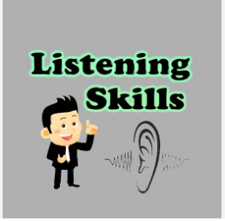

Slide 2
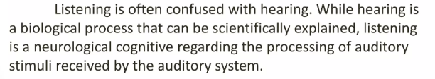
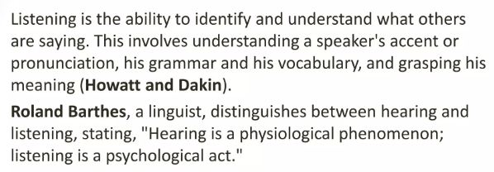
Listening Skills

Slide 3
Listening skills involve more than just hearing; they require actively focusing on, understanding, and responding to a speaker by using non-verbal cues, asking clarifying questions, and suppressing distractions and your own internal responses. To improve, practice active listening by giving undivided attention, using eye contact and body language to show engagement, and paraphrasing to confirm understanding. Be patient, avoid interrupting, and maintain an open mind to foster better communication and stronger relationships.

Slide 4
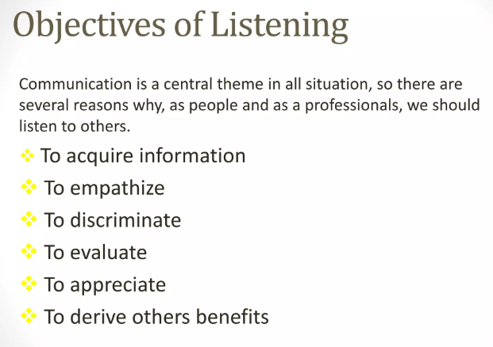

Slide 5
Stages of the Listening Process
1. Receiving (Hearing) – Taking in sounds or spoken words.
2. Understanding – Assigning meaning to the message.
3. Remembering – Storing information for use.
4. Evaluating – Analyzing the message critically.
5. Responding (Feedback) – Giving verbal or non-verbal feedback.

Slide 6
Types of Listening
1. Active Listening – Fully concentrating and responding thoughtfully.
2. Critical Listening – Analyzing and evaluating the message.
3. Empathetic Listening – Understanding emotions behind the words.
4. Comprehensive Listening – Focusing on meaning of information.
5. Appreciative Listening – Listening for enjoyment.

Slide 7
Key Components
• Attention – Focusing on the speaker.
• Understanding – Interpreting correctly.
• Retention – Remembering information.
• Response – Giving appropriate feedback.

Slide 8
Importance of Listening Skills
• Builds strong relationships.
• Improves learning and knowledge.
• Enhances problem-solving and decision-making.
• Reduces conflicts and misunderstandings.
• Encourages respectful communication.

Slide 9
Barriers to Listening
Barriers to the listening process may create misunderstanding and confusion and may sometimes lead to communication breakdown.
* Physical Barriers: Physical distractions and disturbance can easily disrupt the process of listening. Barriers to listening could be noise, physical discomfort, or any physical factor.
* Psychological Barriers: Listener’s disturbed state of mind and disturbance can prove to be a barrier to effective listening because it leads to lack of interest and concentration. Reasons are: feeling of anger, frustration, sadness, anxiety, or fear influence our reception and others’ ideas.

Slide 10
Barriers to Listening
* Linguistic Barriers: this barrier occurs when the speaker is using the language which the listener does not understand. Sometimes the speakers may use difficult words, jargons, technical terminology, or unclear phrases and ambiguous language.
Cultural Barrier: Our values are our personal guides to thought and behavior, and exercise a strong influence on us. If the speaker and the listener belong to different cultures and share different values, listening could become a difficult process.
Ex: Prayer of God in different communities: one does not pay attention to words and lyrics of it.

Slide 11
How to Improve Listening Skills
Give undivided attention:
Avoid distractions like phones or headphones, make eye contact, and use your body language to show you're engaged.
Nod and use other non-verbal cues:
Show your engagement with occasional nods and facial expressions to encourage the speaker to continue.
Don't interrupt:
Allow the speaker to fully express their thoughts without cutting them off or finishing their sentences.
Ask clarifying questions:
Inquire for more information using open-ended questions like "Can you tell me more?" to ensure understanding.
Paraphrase and summarize:
Periodically restate the speaker's key points in your own words to confirm you've understood them correctly.

Slide 12
How to Improve Listening Skills
Maintain an open mind:
Avoid judgment and premature conclusions; set aside your own thoughts and agendas to understand the speaker's perspective.
Manage your internal reactions:
Be aware of your emotional responses and avoid becoming defensive or argumentative, especially in sensitive conversations.
Take notes:
Jotting down key ideas, questions, and important points can help with retention and clarification.
Practice empathy:
Try to put yourself in the speaker's shoes and understand their feelings and perspective to enhance the quality of your interaction.
Seek feedback:
Ask others for constructive criticism on your listening skills to identify areas for improvement.

Slide 13


